Slide 1

The Shakespeare Stealer
Group:
Giovanni Buonomo
Quang Huynh
Dylan LaForce
Jericho Yates
Title
By Gary Blackwood
Notes:
Everyone

Slide 2
Foreshadowing – chapter 1, page 8
“If I had had any notion of what actually lay in store for me, I might have not wished so hard for it.”
Hyperbole – chapter 6, page 37
“Close your mouth before your soul flies out’
Simile – chapter 11, page 77
“Until today, there had been but one of demands upon me. Now two threats hung over me, like the buildings in that narrow, stinking alley.”
Personification – chapter 23, page 177
“My lines, which were not yet securely seated in my brain, flew from it like startled birds.”
Alliteration – chapter 27, page 197
“The feeling of being flung into that whirling world of water is one I fervently hope never to experience again.”
Literary Techniques
Notes:
Jericho

Slide 3

Setting
The overall setting is London. London is a big city with many buildings and dark, gloomy woods.
Some minor settings are Leicester, a small village in England. Secondly, Simon Bass’s home, which was dark and had a low roof. Last but not least, the Globe Theatre, an eight sided building with well dressed patrons and there was also a lower class. After that, there was a carving of Atlas with a Globe on shoulders above the Entrance.
It took place in the 1590s.
Extra Credit:
Chapter 6, Pages 36-37
“All around us lay fields and orchards; I might have imagined I had never left home had I not looked dead ahead, where the thousand buildings of the city, with their red tile roofs, lay ranged in rows within the ancient stone wall, so densely packed that those which lined the river seemed about to be nudged into it by those on the hill above.
Notes:
Dylan

Slide 4
Conflict
Mr. Armin and Falconer were fencing for the play. During the fight, Widge took the book. Mr. Armin had acritical hit on Falconer. Falconer had revealed that he is Simon Bass before he died.
Widge saw Nick and Falconer talking. Nick then tried to steal the play book and Widge hid behind a crate, watching Nick. Nick hit Widge with his rapier in the protective area. Sander then comes in, sees Widge and defends him.
Widge was trying to copy down the play from behind the curtain. The cannoneer saw him and started screaming at Widge. The cannoneer had fired a shot, but missed the shot, starting a fire.
Widge loses his notebook and is caught by Mr. Pope. Widge then lies and says he wants to become a player. After that, Mr. Pope takes Widge in to meet Sander.
Notes:
Quang

Slide 5

Characters
Widge
A fourteen year old orphan who was an apprentice. He is the protagonist and learns charactery from Dr. Bright. Widge also lies a lot and is sent to the Globe Theater by Falconer to steal a play. Widge later learns words such as honesty, trust, loyalty and friendship. Widge is very obedient and independent.
Dr. Bright
Dr. Bright was a doctor and preacher who studied medicine at Cambridge. He was the one who adopted Widge and then since he was so devised in charactery, had taught Widge charactery. He was Widge’s first master and owned him for 7 years until Dr. Bright had sold Widge to Falconer for 10 pounds of sterling. He is serious and very smart.
Falconer
A Jewish man who works for Simon Bass. Falconer is the one who bought Widge and took him to London to steal a play. He is good with a sword and has a scar on his face. Falconer is very mysterious and not very friendly.
Sander
An apprentice who is very good friends with Widge. Sander shares old clothes, a bed and a room with Widge in the theater and shows Widge what it feels to have a true friend. Sander helps Widge with things and also shares a lot with him. Sander is very kind and friendly.
Mr. Armin
Mr. Armin is a fencing teacher at the playhouse. He plays the first gravedigger in Hamlet and is the one who killed Falconer. In general, Mr. Armin is tough and brave.
Julian/Julia
A female apprentice disguised as a boy so she can play parts in Hamlet. She plays Ophelia in the play. Her mother is dead and Julia grew up in the bad part of town. Also, she is stabbed by Nick and lives with Mr. Phillips and his wife. She had to leave for France to become an actor, and is a good friend of Widge. She is not friendly due to her attitude towards Mr. Pope.
Nick
A very mean and rude apprentice who drinks and calls Widge “horse.” He was an apprentice for 6-7 years already and is generally late/does not show up for parts in time. Nick and Widge are enemies.
Mr. Heminges
Mr. Heminges was the book keeper. He is the boss/runs the company and is doubtful due to his stuttering in his speech.
Notes:
Giovanni

Slide 6
Plot
The climax of The Shakespeare Stealer is when Nick steals Hamlet which leads Widge and Mr. Armin chase after Nick.
The resolution is when Mr. Armin and Falconer had the fencing fight, which had resulted in Falconer dying.
Notes:
Dylan

Slide 7
Theme
A theme found in the play was friendship. An example of this is when Widge makes his first friend, Sander. They help each other out and even share a room in the theater. Another example is that, instead of catching Nick, Sander decides to take care of Widge.
Notes:
Quang

Slide 8



Symbols
This symbol represents Widge as an orphan at a young age.
The rapier represents the weapon of the time and lots of people using it as a prop. Also, they always duel and with it.
London represents the freedom of Widge and it reminds him of country boys.
Notes:
Jericho

Slide 9
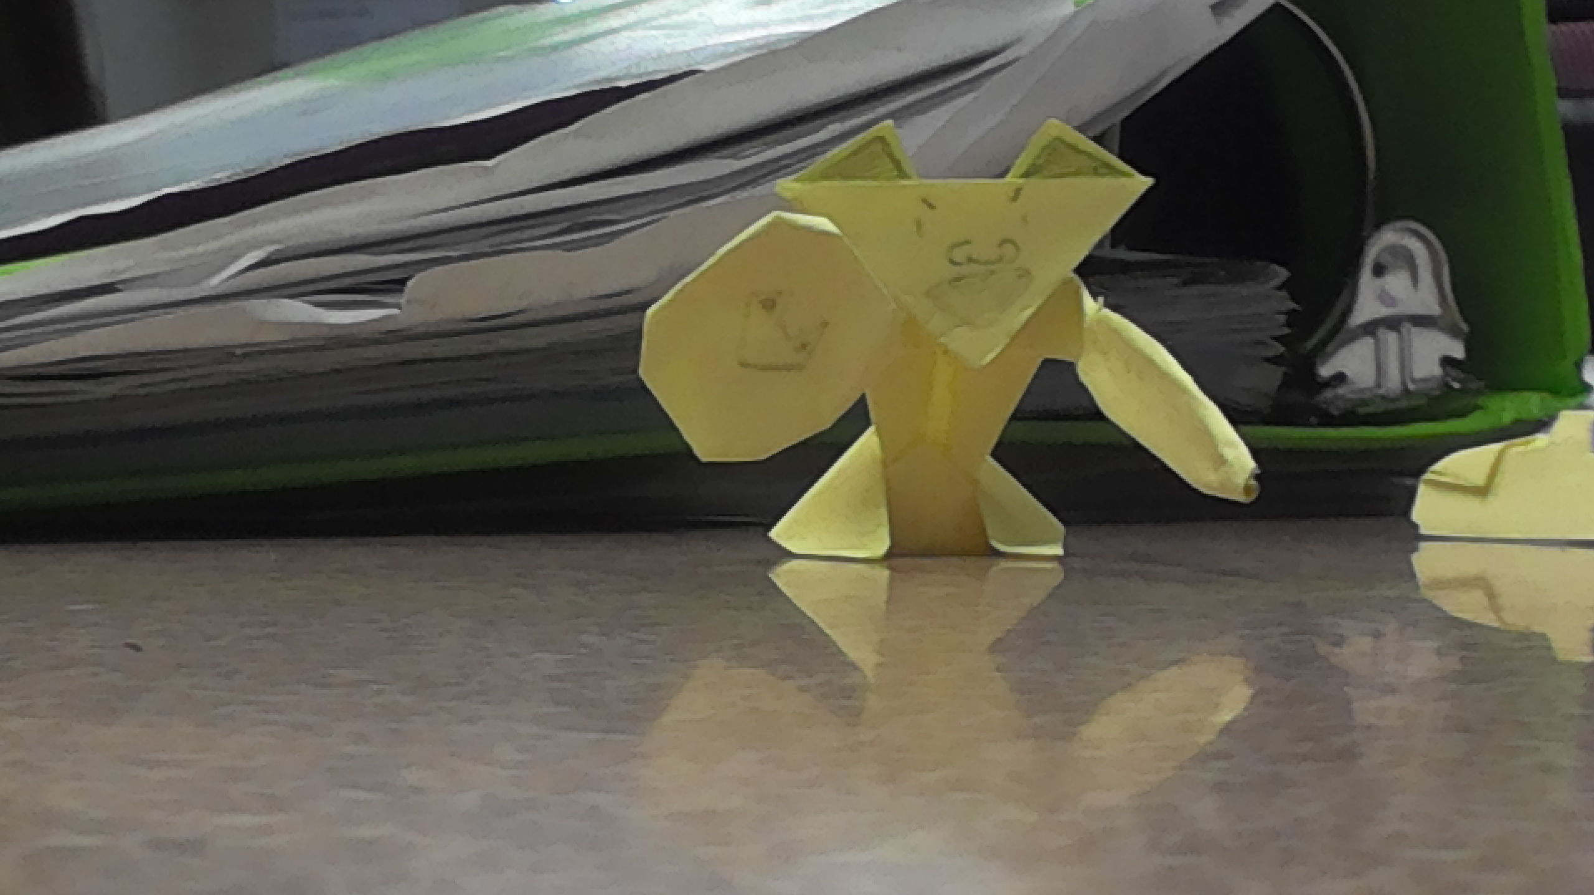
ǝnp sɐʍ ʇᴉ ǝɹoɟǝq sʎɐp Ɛ ɯɐ ᄅ ʇɐ ʇɔǝɾoɹd ǝloɥʍ ǝɥʇ ƃuᴉdʎʇ puɐ ƃuᴉʇᴉɹʍ ɹoɟ ƃuɐnQ oʇ ʇᴉpǝɹɔ

